Slide 1

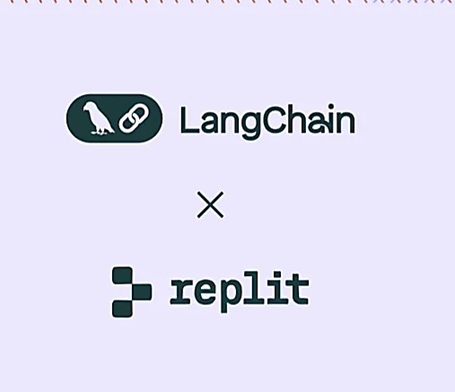
Case Study:
Replit Agent – Pushing the Frontiers of Agentic AI
Company: Replit
Industry: Software Development Platform
Use Case: AI-powered app creation & collaborative coding
Reference: LangChain Case Studies
Presented by: Hadeel Awaji
Department: Imam Mohammed bin Saud University / CS

Slide 2
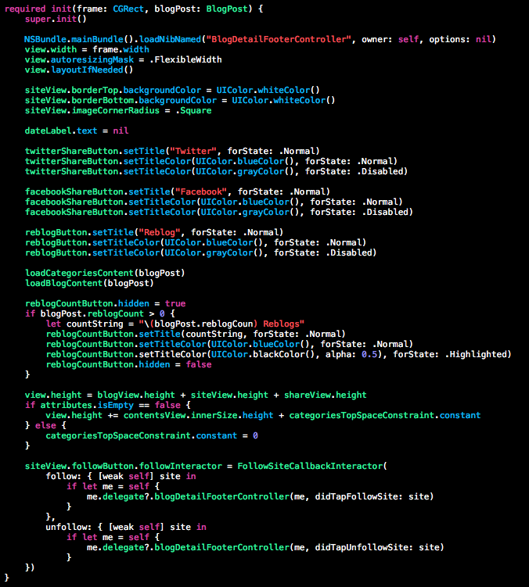
Problem / Challenge
Sessions are complex, with hundreds of steps
Standard tools track only single API calls
Massive trace data is hard to analyze
Debugging specific issues is time-consuming

Slide 3
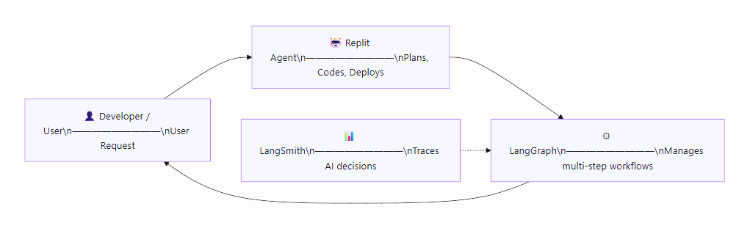
Solution Overview
Replit Agent: AI assistant for building full applications
LangGraph: Manages complex, multi-step workflows
LangSmith: Traces execution flow from start to finish
Developers gain granular visibility into AI decisions

Slide 4
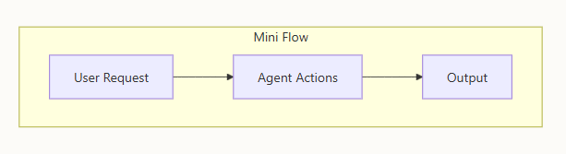
Agentic Functions & Roles
Autonomous Planning: Determines project steps
Tool Usage: Sets up environments, installs dependencies
Decision-Making: Chooses when to write, review, and deploy code
Multi-Agent System:
Managing Agent: Coordinates project
Editing Agent: Writes/modifies code
Verifying Agent: Checks code quality
example workflow:
User: "Build a weather app" → Plans → Sets up server → Installs libraries → Writes code → Deploys live site

Slide 5



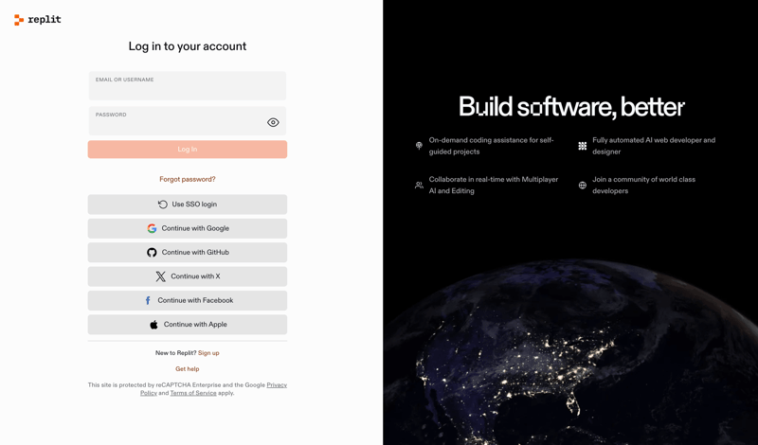
Non-Agentic Components
LLM APIs (external text processing)
Backend storage & data ingestion
Frontend UI / charts
Observability platform (records agent actions)

Slide 6


Benefits & Key Takeaways
Faster Debugging: Search traces for issues
Holistic Context: Understand AI reasoning
Human-in-the-Loop: Users can correct AI paths
Scalable: Handles millions of users
Agentic AI Lesson: AI can plan, reason, and execute, while traditional software supports it

